Slide 1


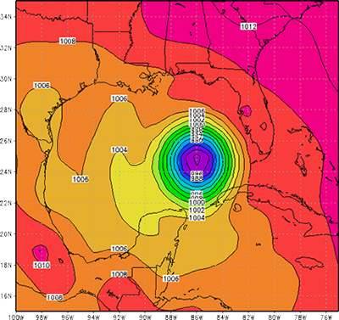
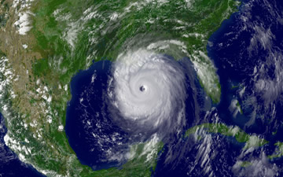
Adapting NASA’s MAPSS Databases to Desktop Computing Southwestern Oklahoma State University
Hayden Webb | Devin Smoot | Department of Computer Science
Abstract
What is WRF?
WRF Pressure Model
The capability of desktop computers has increased greatly over the past several decades, even outpacing some of the first supercomputers. A standard Intel i7-4790 processor can run at 90 Gigaflops. This means it can complete almost ten to the tenth operations per second. Hence, in a time when you can buy a new 8th generation intel processor for a few hundred dollars, an older 4th generation intel processor is more powerful than the most powerful computer in the world in 1993.
In this research, we examine code developed for a NASA supercomputer and run it on a standard personal computer. Our results suggest that for simple tasks, such as pulling down information from the servers, the software is capable of running on a standard desktop. This demonstrates that when NASA produced code is adapted to a modern desktop computer, the computer can process the given information.
In summary, we can show that modern desktop computers not only have more processing power than some of the first supercomputers, but can easily handle applications attended for processing large sums of data. From a larger perspective, this shows how computers evolved to the point where what is considered an outdated processors is still leagues above what was first produced. This material is based upon work supported by the National Aeronautics and Space Administration under Grant No. NNX15AK02H NASA Oklahoma Space Grant Consortium.
The Weather Research and Forecasting model (WRF) was created by the National Center for Atmospheric Research (NCAR).
The software works to model a large range of meteorological events.
It functions as a forecasting application and supports atmospheric research.
The software was has several extensions to allow for the study and modeling of the water cycle, wild fire, air chemicals, and more.
Katrina Case Study
Conclusion/Plan
After several weeks of hard work we were able to accomplish several of our desired goals. First, we established a Raspberry Pi cluster for the purpose of running the WRF software. Next, we were able to completely install WRF and all of its required libraries. This means that are cluster is ready to begin processing real-time weather data. Finally, our system is ready pull the data for weather forecasting down through the MOReOFFN internet 2 layer. As the project proceeds we are excited and prepared to expand and explore research with the WRF and MAPSS software.
What is MAPSS?
Goals Moving Forward
Multi-sensor Aerosol Products Sampling System (MAPSS)
It is used to create a consensus between different aerosol sensors.
It has access to a collection of both ground and space based sensors.
The sensors include AERONET, MODIS, MISR, OMI, POLDER, CALIOP, and SeaWiFS.
MAPSS is used to confirm and compare data across the different sensors.
MAPSS is open to the public and thus allows scientist and researchers across the world to use the collected data.
Works Cited
* Gain the ability to do real time forecasting with current weather data provided by NOAA
* This research will lead to further combined research involving the NASA MAPSS project for modeling aerosol data analyzed in the atmosphere.
* This research will also lead to WRF and MAPSS being run on not only the Raspberry Pi cluster but also a Virtual Cluster developed with Virtual Machines on either a desktop or server. It can then be translated to enterprise level servers and actual supercomputing systems.
* Understand WRF (Weather Research and Forecasting) software and how to run real time forecasting models as well as historical models
* Run on a Raspberry Pi cluster of only 8 nodes
* Pull-down real-time weather data across the MOReOFFN internet 2 layer from NOAA
Petrenko, M., Ichoku, C., & Leptoukh, G. (n.d.). Multi-sensor Aerosol Products Sampling System. Retrieved March 5, 2019, from https://ntrs.nasa.gov/archive/nasa/casi.ntrs.nasa.gov/20120003903.pdf
GES DISC. (n.d.). MAPSS (A Multi-sensor Aerosol Products Sampling System). Retrieved March 5, 2019, from https://disc.gsfc.nasa.gov/information/glossary?title=MAPSS%20(A%20Multi-sensor%20Aerosol%20Products%20Sampling%20System)
University Corporation for Atmospheric Research. (2018, November 7). WRF ARW Online Tutorial. Retrieved March 5, 2019, from http://www2.mmm.ucar.edu/wrf/OnLineTutorial/CASES/SingleDomain/index.html
Work Plan
The original work plan was to convert the MAPSS database to a desktop computer application. This project is building on the work done by past SWOSU students. These previous students had already managed to get several of the sensor’s data working on the desktop computer. This complete work had to be gathered and updated to fit the current version of Python. A major part of the project was going to be setting up the appropriate libraries for each sensor. When this was discovered we decided to change software to WRF before later returning to MAPSS.

